Slide 1
MOVIE MANAGEMENT SYSTEM
DATABASE SYSTEMS

Slide 2
introDUCTION
Our Movie Management System is a comprehensive platform designed to efficiently organize, track, and manage movie data. It offers features like movie cataloging, user reviews, and booking management for a seamless cinematic experience
Project: Movie Management System
Team: Hamza, Farwa, Ayesha
Course: Database Systems
Date: 11/06/25

Slide 3
Motivation
The User's Problem:
Finding local cinema showtimes is inconvenient.
Checking which service (Netflix, Prime, etc.) is streaming a movie requires visiting multiple apps.
There is no easy way to see all viewing options in one place.
Our Solution:
Create a one-stop platform for all movie-related information.
Allow users to search for a movie and see both cinema and streaming availability instantly.
Develop a powerful admin panel for simple, centralized content management.
Goal:
Simplify movie discovery and create an efficient admin panel.

Slide 4
Technology Stack
Database: WAMP Server (MySQL)
Backend: PHP
Frontend: HTML, CSS,
Framework: Tailwind CSS

Slide 5
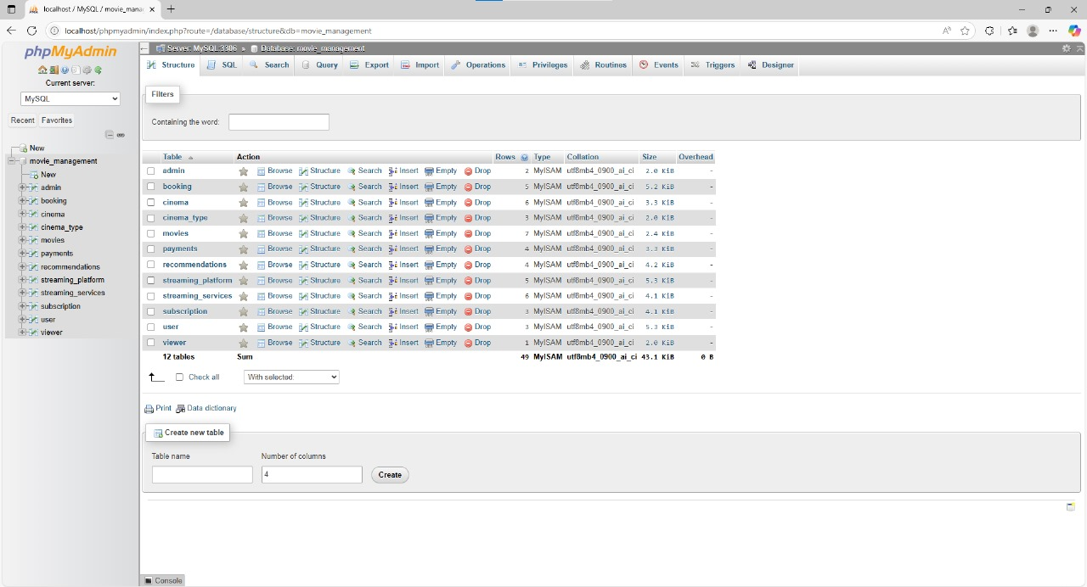
SCREEN SHOTS:
PHP MY LOCAL ADMIN
FULL DATABASE ALONG WITH TABLES

Slide 6
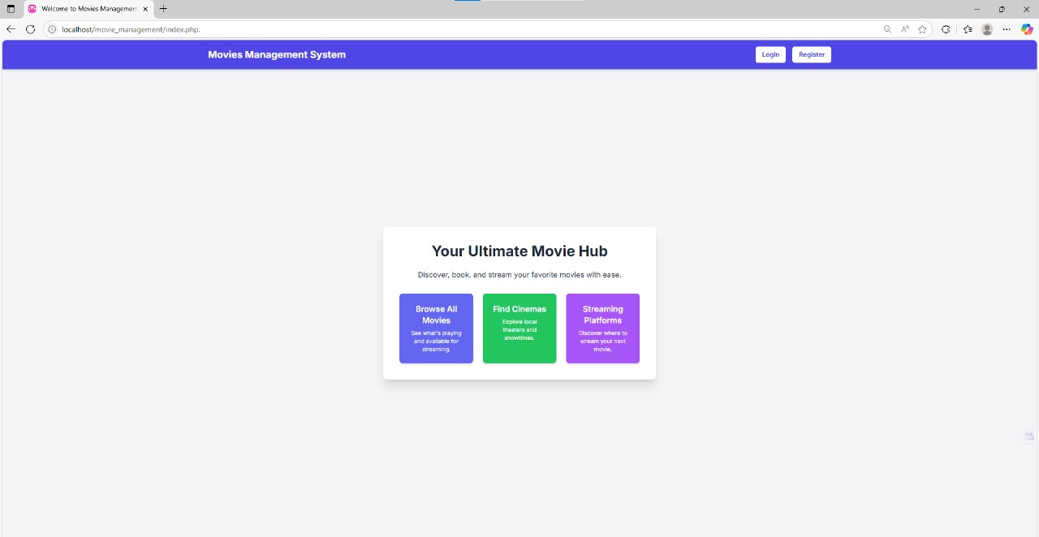
SCREEN SHOTS:
INDEX PAGE
BROWSE MOVIES
CHECK STREAMING PLATFORM
FIND CINEMAS

Slide 7
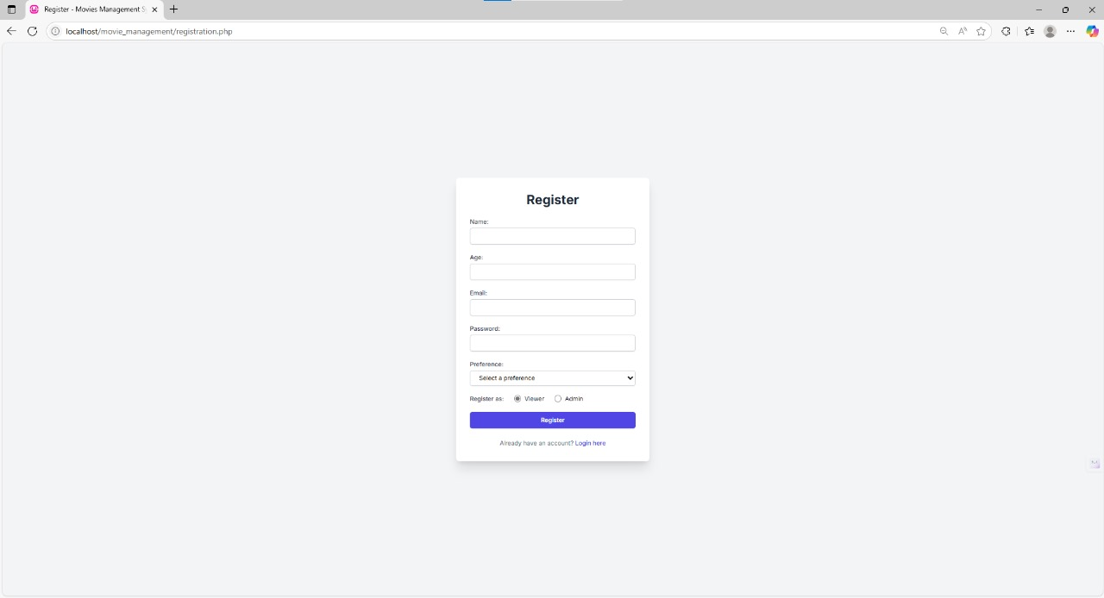
SCREEN SHOTS:
REGISTERATION PAGE
USER CAN REGISTER AS AN ADMIN OR VIEWER
LOG IN OPTION

Slide 8
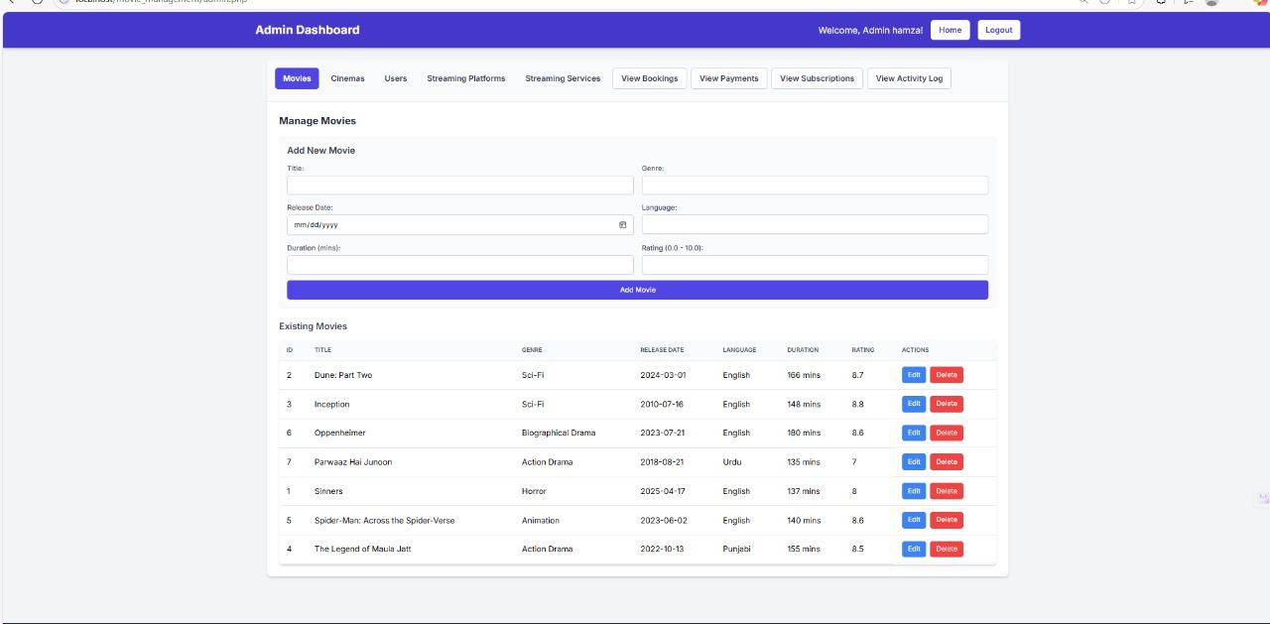
SCREEN SHOTS:
ADMIN DASHBOARD
ADD MOVIES
EDIT or DELETE MOVIE

Slide 9
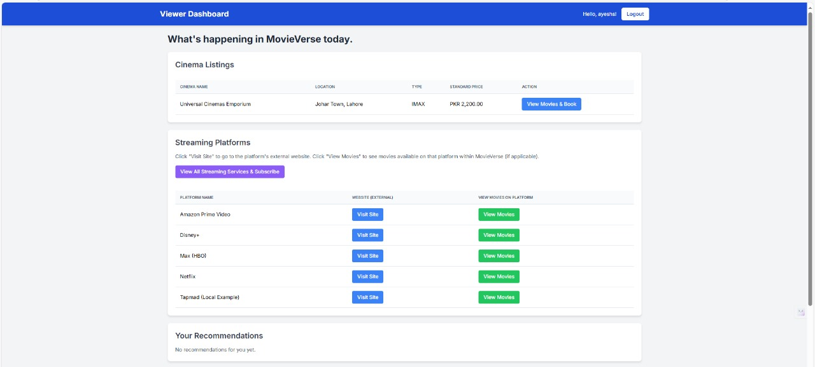
SCREEN SHOTS:
VIEWER DASHBOARD
BOOK A CINEMA SEAT
VISIT THE WEBSITE and VIEW MOVIES OPTION

Slide 10
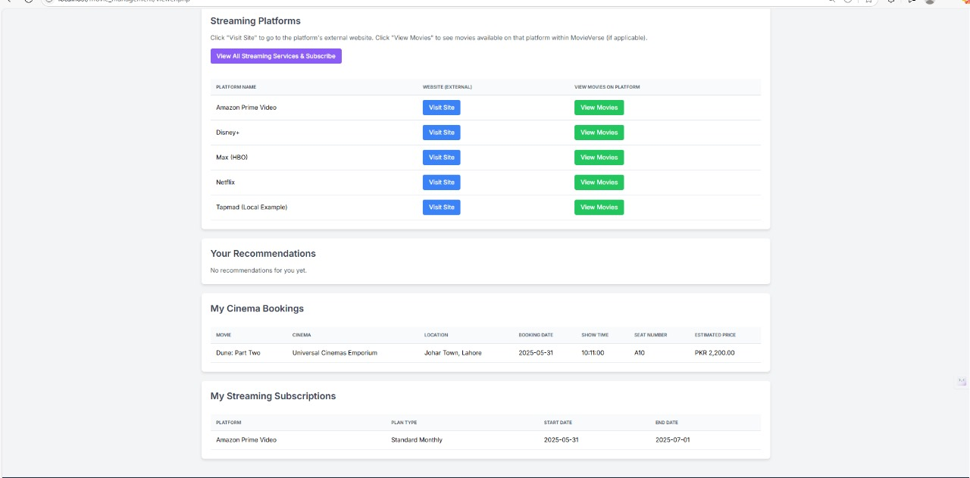
SCREEN SHOTS:
VIEWER DASHBOARD: STREAMING PLATFORMS
RECOMMENDATIONS BASED ON USER ACTIVITY
ALREADY BOOKED CINEMA and STREAMING SUBSCRIPTIONS

Slide 11
Team Contribution
Hamza (Backend & Database)
Built the MySQL database schema.
Helped with Relations and Normalization between tables.
Worked on Logic and PHP coding.
2. Farwa (Frontend & UI/UX)
Worked on Logic and PHP coding.
Styled the UI using Tailwind CSS.
Worked on making presentation.
3. Ayesha (Functionality & Optimization)
Worked on Logic and PHP coding.
Used HTML and CSS for interactive User Interface.
Helped with Documentation.

Slide 12
Thank you!

